Slide 1
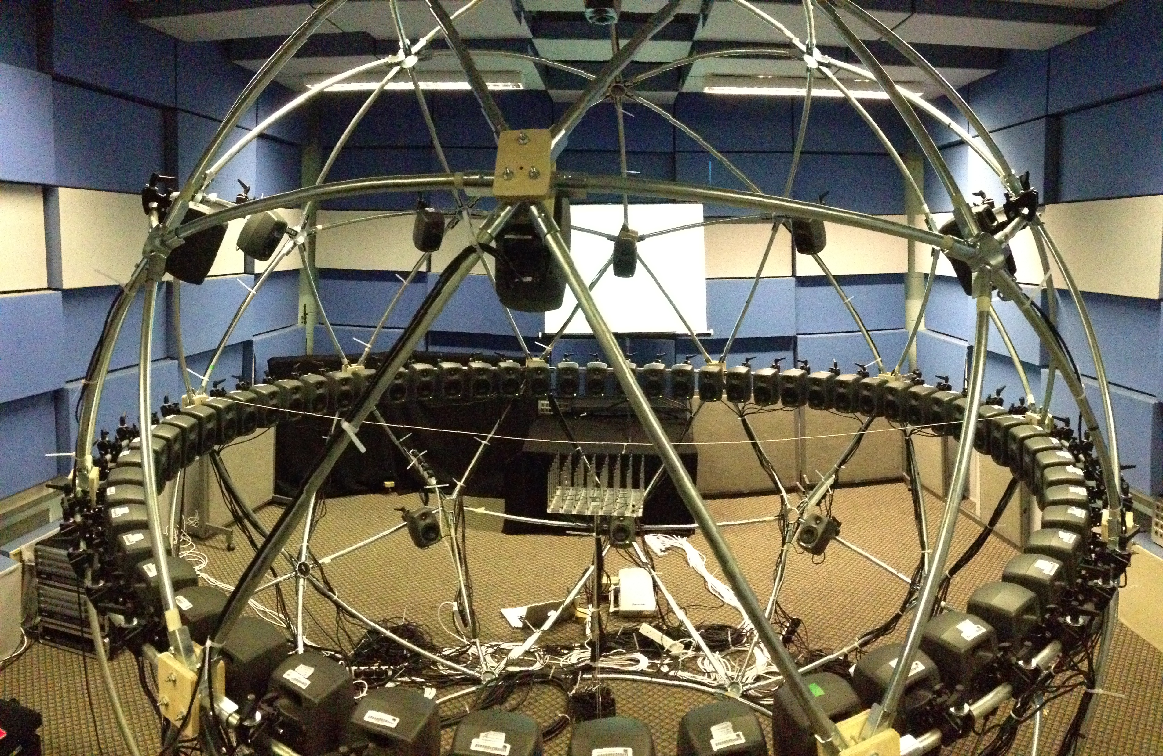
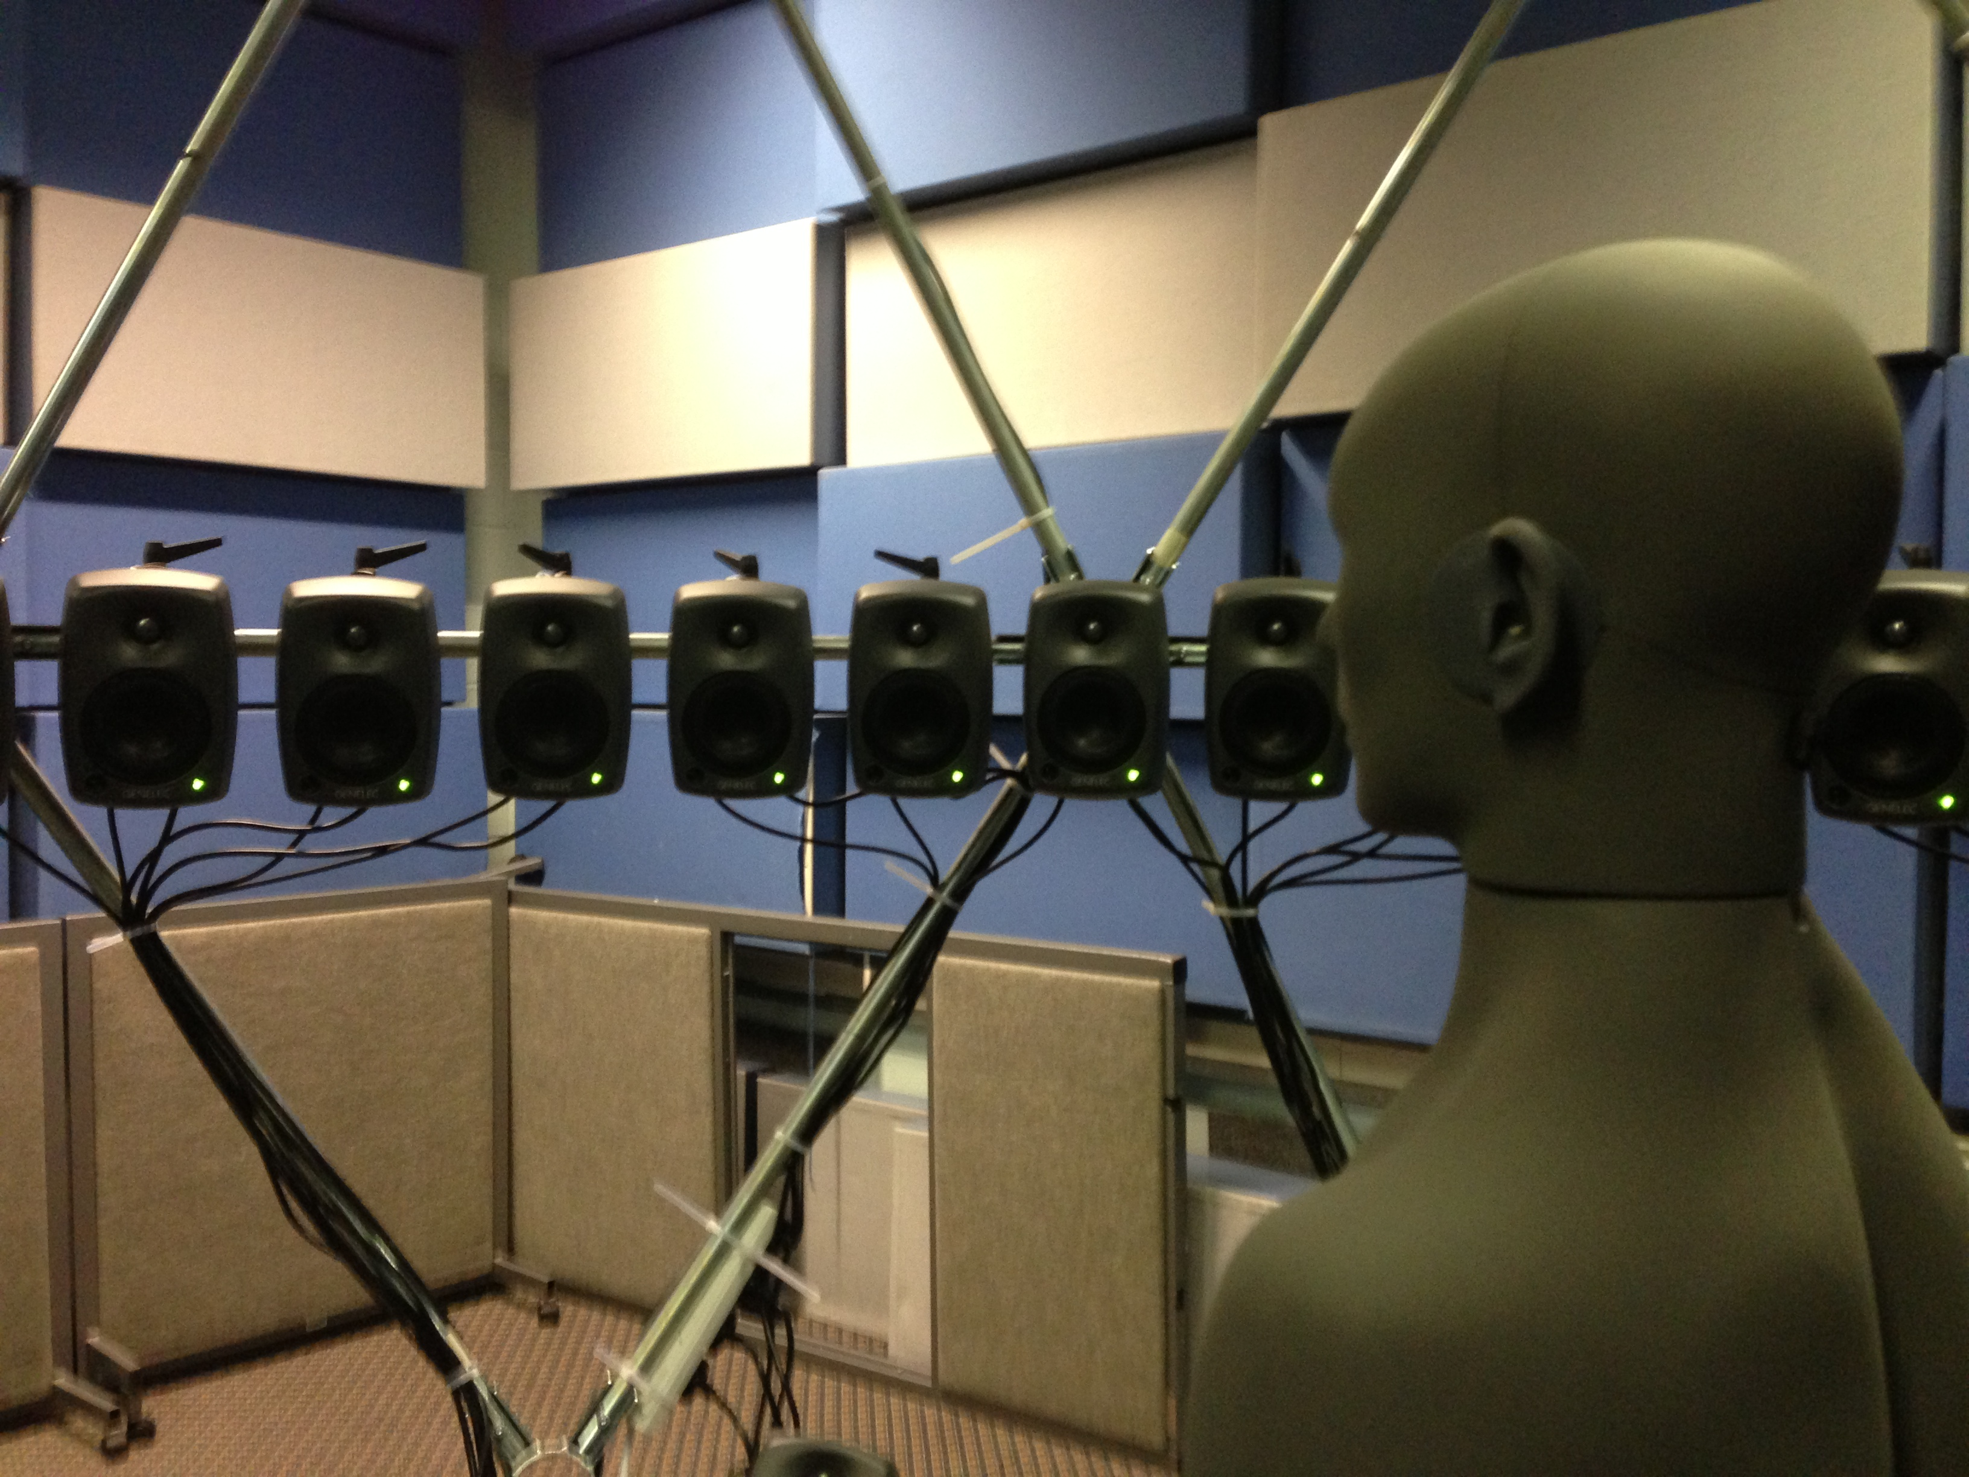
Sound zones
The binaural dummy is poisitioned in zone A, on the right hand side of the sphere.
The audio you hear as the interferer is reproduced, at the same level, in zone B.
The target audio is “On Top” by the Killers.
start
Philip Coleman, Alice Duque, Philip Jackson, Marek Olik
University of Surrey, Guildford, UK
BBC Audio Research Showcase 2013
www.posz.org

Slide 2
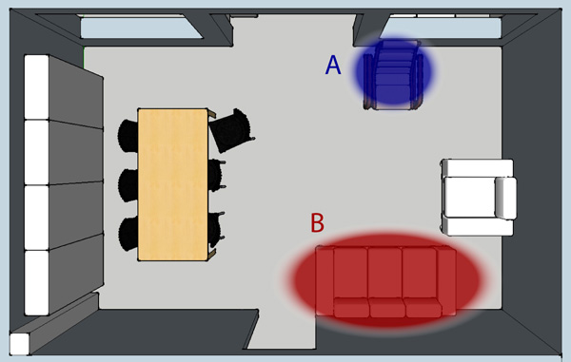
Introduction
Sound zone reproduction aims to use an array of loudspeakers to deliver independent audio programme material to two listeners sharing the same room.
A number of optimization approaches have been proposed for sound zone creation. At Surrey, we have realised a 60 channel circular array surrounding 2 zones, where we can compare the performance of these approaches.
We have made recordings of representative approaches using a binaural head and torso simulator placed in one zone, where there is audio being simultaneously delivered to the other zone.
next
www.posz.org

Slide 3
Demonstrations
Here, we present two approaches for creating a planar listening region combined with a cancellation region:
Pressure Matching (PM) [1]
Matches the complex pressures in a least-squares sense to reproduce a plane-wave in the bright zone and zero pressure in the dark zone.
The target plane wave impinges from directly ahead of the listener (0 degrees)
Planarity Control (PC) [2]
A novel method that minimizes the dark zone pressure whilst constraining the bright zone energy flux to arrive from a range of azimuths.
In the mono case, the plane wave can arrive from -40 to +40 degrees;
in the stereo case, it is tightly constrained to come from -30 degrees for the left channel and +30 degrees for the right channel
M. Poletti, “An investigation of 2-d multizone surround sound systems”, in Proceedings of the 125th Audio Engineering Society Convention, San Francisco, CA, 2-5 October 2008.
P. Coleman, P. Jackson, M. Olik, and J. Pedersen, ”Optimizing the planarity of sound zones," in Proc. 52nd AES Int. Conf. Sound Field Control - Engineering and Perception, Guildford, UK, 2-4 September 2013.
next
www.posz.org

Slide 4
Sound zones
Now playing:
Pressure Matching
Planarity Control
Planarity Control, stereo
The audio you hear as the interferer is reproduced, at the same level, in zone B.
The programmes are bandlimited to 100-7000Hz.
The target audio is “On Top” by the Killers.
www.posz.org

Slide 5

Sound zones
Now playing:
Pressure Matching
Planarity Control
Planarity Control, stereo
The audio you hear as the interferer is reproduced, at the same level, in zone B.
The programmes are bandlimited to 100-7000Hz.
The target audio is “On Top” by the Killers.
www.posz.org

Slide 6
Sound zones
Now playing:
Pressure Matching
Planarity Control
Planarity Control, stereo
The audio you hear as the interferer is reproduced, at the same level, in zone B.
The programmes are bandlimited to 100-7000Hz.
The target audio is “On Top” by the Killers.
www.posz.org

Slide 7
Sound zones
Now playing:
Pressure Matching
Planarity Control
Planarity Control, stereo
The audio you hear as the interferer is reproduced, at the same level, in zone B.
The programmes are bandlimited to 100-7000Hz.
The target audio is “On Top” by the Killers.
In the stereo case, the zone B audio is also reproduced in stereo.
www.posz.org

Slide 8

Thanks!
We hope you enjoyed the sound zone demonstration!
Further information and a list of our publications can be accessed through the project website
www.posz.org
Please keep in touch!
p.d.coleman@surrey.ac.uk
www.linkedin.com/in/philipcolemanaudio
finish
www.posz.org

